Slide 1
NLU Share——
Papers about Disfluency Detection
Shared by QuQin, 2017.02.19

Slide 2
Contents
01 What is disfluency detection
02 Current Studies
03 A Neural Attention Model
04 Enhancing Neural Disfluency Detection
with Hand-crafted Features
— * —

Slide 3
01 What is
02 Current Studies
03 Paper1
04 Paper2
A flight to Beijing Wuhan Tuesday
我们在正心楼，嗯，不，还是在主楼见面吧

Slide 4
01 What is
02 Current Studies
03 Paper1
04 Paper2
Disfluency of a sentence can be categorized into five classes (Wu et al., 2015)
Uncompleted words
Filled pauses (e.g. “uh”, “um”)
Editing terms (e.g. “you know”)
Discourse markers (e.g. “I mean”)
Repairs that are discarded, or corrected by its following words
Efficient disfluency detection with transition-based parsing
http://wing.comp.nus.edu.sg/~antho/P/P15/P15-1048.pdf

Slide 5

01 What is
02 Current Studies
03 Paper1
04 Paper2
disfluencies annotated in the style of (Shriberg, 1994)
FP=Filled Pause
RM=Reparandum ( 待修正语 )
IM=Interregnum
RP=Repair ( 修正语 )
Preliminaries to a theory of speech disfluencies
https://www.researchgate.net/publication/2325587_Preliminaries_to_a_Theory_of_Speech_Disfluencies

Slide 6
01 What is
02 Current Studies
03 Paper1
04 Paper2
Sequence tagging methods (Ferguson et al.,
2015; Georgila, 2009)
carefully designed features required
sparsity problem
cannot keep the generated sentences grammatical
Disfluency detection with a semi-markov model and prosodic features http://www.aclweb.org/website/old_anthology/N/N15/N15-1029.pdf
Using integer linear programming for detecting speech disfluencies
http://www.aclweb.org/anthology/N09-2028.pdf

Slide 7
01 What is
02 Current Studies
03 Paper1
04 Paper2
(2) syntax-based disfluency detection works
(Honnibal and Johnson, 2014; Wu et al., 2015)
data that both have syntax trees and disfluency annotations are scarce
performance of syntax parsing models hinders disfluency detection’s performance
Joint incremental disfluency detection and dependency parsing
http://acl2014.org/acl2014/Q14/pdf/Q1402.pdf

Slide 8
01 What is
02 Current Studies
03 Paper1
04 Paper2
(3) RNN method (Hough and Schlangen, 2015)
doesn’t model the transition between tags
cannot keep the generated sentences grammatical
Recurrent neural networks for incremental disfluency detection
http://www.isca-speech.org/archive/interspeech_2015/papers/i15_0849.pdf

Slide 9
01 What is
02 Current Studies
03 Paper1
04 Paper2
A Neural Attention Model for Disfluency Detection
=> Input Representation
w: a learned word embedding
: a fixed word embedding
p: a learned POS-tag embedding
d: a hand-crafted feature representation

Slide 10
01 What is
02 Current Studies
03 Paper1
04 Paper2
A Neural Attention Model for Disfluency Detection
=> Encoder
bidirectional LSTM-based RNN

Slide 11
01 What is
02 Current Studies
03 Paper1
04 Paper2
A Neural Attention Model for Disfluency Detection
=> Attention-based Decoder
select a word from the candidate words (x_{i}, ...x_{j}) rather than on a fixed output dictionary
once a word x_{k} is selected, all the words (x_{i}, ..., x_{k−1}) will be deleted and the candidate words in the next step will be (x_{k+1}, ...x_{l})

Slide 12
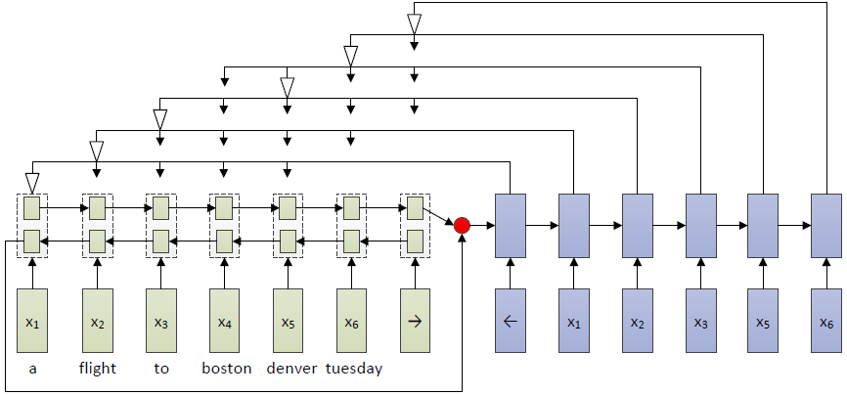
01 What is
02 Current Studies
03 Paper1
04 Paper2
A Neural Attention Model for Disfluency Detection
=> Attention-based Decoder

Slide 13
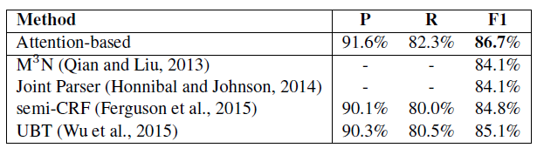
01 What is
02 Current Studies
03 Paper1
04 Paper2
A Neural Attention Model for Disfluency Detection
=> Model performance
Comparison of the neural attention-based model with the previous methods on the test set of English Switchboard data

Slide 14
01 What is
02 Current Studies
03 Paper1
04 Paper2
第一步 品牌诊断/品牌审计/品牌评估
品牌诊断、品牌审计及品牌评估的三者含义相近，其目的都是为了全面检视品牌现状，了解品牌的竞争力和健康程度。品牌诊断是所有工作的开始，但根据不同的实际情况诊断的层次和内容也不同。
对于一个全新的品牌，这种诊断叫做品牌调查或许更恰当，它主要是对目标市场和目标消费群体的调查研究，这与一般意义上的市场调查不同，它还包括对目标消费群体的品牌需求的调查分析，目的在于发现某种品牌需求，需要对目标消费群体进行深入的沟通和研究，发现他们心中未被其他品牌开发的处女地，然后后面的工作就是对这块处女地的开发建设和管理。
而对于一个已经有一定品牌基础的品牌来讲，这时候的工作，还应包括对原品牌的诊断，品牌文化依托、品牌识别、品牌价值、品牌资产、品牌战略、品牌传播行为、品牌维护等要素的诊断等。这些诊断可以归为对市场的诊断和对自身的诊断，但还必须包括对竞争者的调查研究，这样才能制定出合理的品牌战略。

Slide 15
Thank You

